Slide 1
Finance And Risk Analysis Portfolio Summary
Sruthi Thabati

Slide 2
Agenda
Objective
Investor profile
Data Exploration
investment strategy
Portfolio Performance.
Notes:
In this presentation I’ll present you portfolio of stocks suitable for Mr. Patrick & Peter based on their profile by analyzing the historical stock data from NYSE (New York Stock Exchange).

Slide 3
Objective
Understand the provided information for 24 stocks belong to different domains of leading companies listed in New York Stock Exchange(NYSE)
Create interactive visualization dashboards and evaluate the performance metrics that help to summarize the stock.
Obtain results to create a portfolio of stocks that have the potential to meet the financial goals of the investors.
Notes:
Our main objective is to create a portfolio of stocks that have the potential to meet the financial goals of the investors.

Slide 4
Preview of the Summary
Based on evaluation of the stocks and portfolio metrics
High Returns & High Risk:
AMZN, MSFT, AAPL are stocks with high returns and high risk.
Low Returns with Low Risk:
MRK,JNJ,RHHBY,GS,PFE are stocks with low risk and low returns.

Slide 5
Mr. Patrick Jyengar & Peter Jyengar Profiles
Mr. Patrick Jyengar
Mr. Peter Jyengar
Mr. Patrick is maintaining a decent standard living;
Post his retirement and he wants to invest $500K in stocks.
Expects doubling his capital with less Risk in 5 Years time to buy a minority portion of Naruto(Magazine).
Mr. Peter Jyengar Consistent with his attitude towards risk.
Believes that he can still bounce back in case of any occasional losses.
He Wants to invest $1 million from company's cash and cash equivalents in the most high-margin stocks.
Expects high returns within 5 years for inorganic expansion of his company.
Notes:
Based on the requirements let’s review the investor profiles. Mr.Patrick wants to invest 500k on his post retirement and expecting doubling his capital with less risk within 5 years .
On the Other hand Mr.Peter wants to invest 1 million from company’s cash in the most high margin stocks and he is a risk taker and expects high returns with in 5 years.

Slide 6
Data Exploration
I've analyzed the last five years of data as the investors want to invest for the next five years. So, from the given dataset, I've taken the latest five years of data from 2015/10/01 to 2020/09/30.
We did data Normalization before the visualizations.
For visualization here we used Tableau.

Slide 7
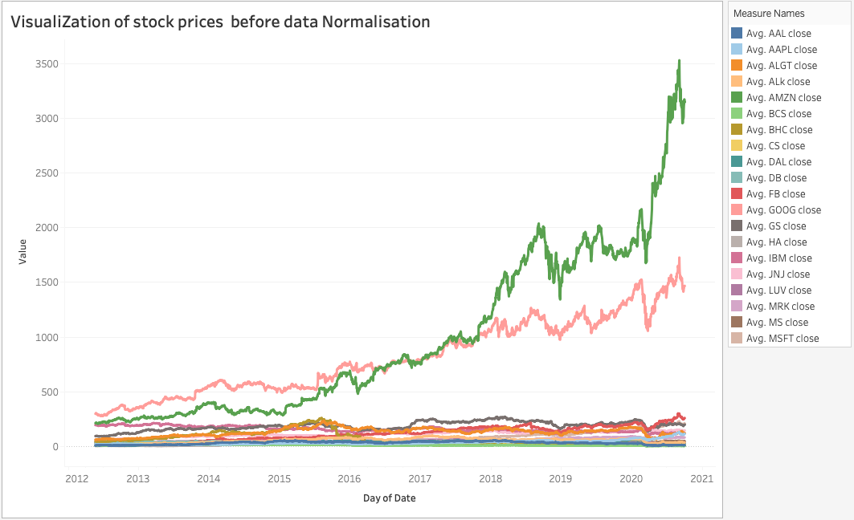
Visualization of the Stocks before Normalization of the data

Slide 8
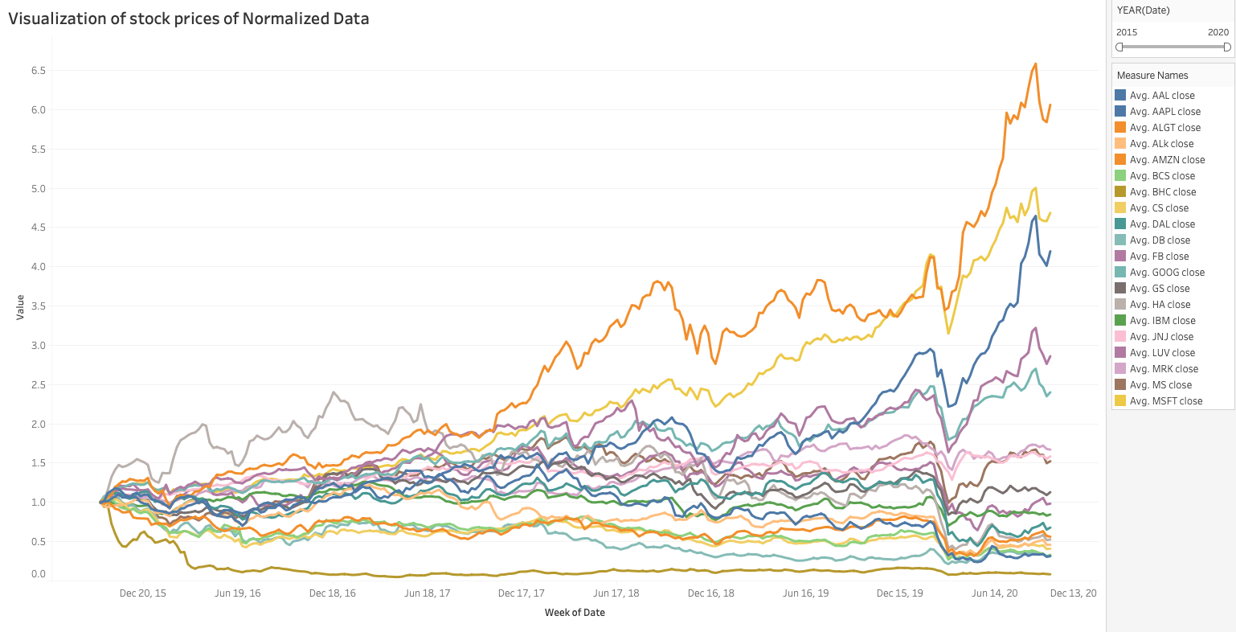
Visualization of the Stock Prices
Observation: Here we can observe that all the stocks went down around Feb and March of 2020 due to Corona Pandemic.
Insight: Among all the stocks 8 stocks are giving more than 70% returns in 5 years period.

Slide 9
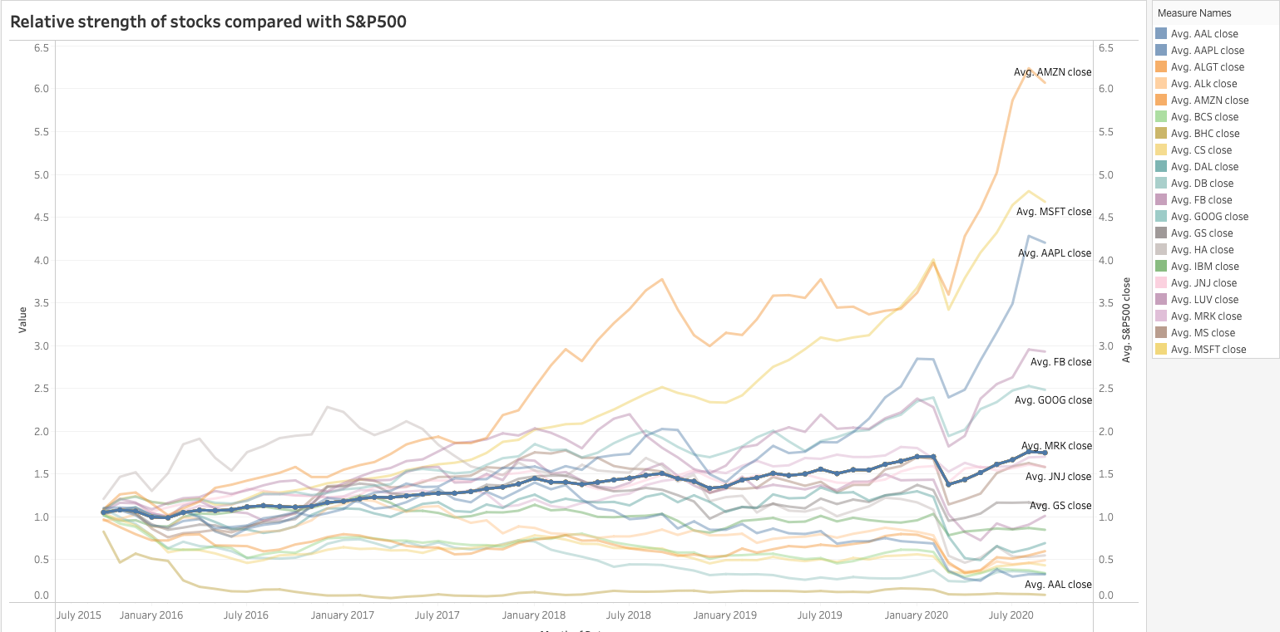
Relative strength of stocks compared with S&P500
In this visualization we can see how the relative strength of the stocks with the given market benchmark S&P500 price
Google, MSFT, AMZN, AAPL, FB, MRK performing better than the market index S&P500.
Here the Thick blue color line indicates S&P500 Market Index.

Slide 10
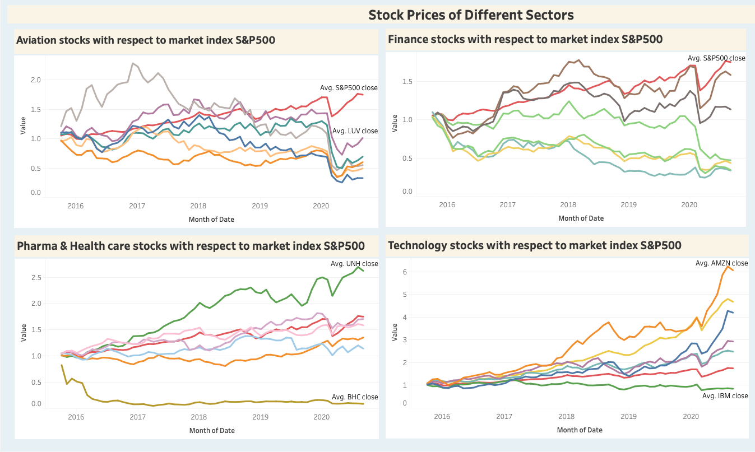
Stock prices of different sectors compared with S&P500
When we Observe different sector stocks with S&P500 Market index which is indicated with Red colored line.
1. Aviation Sector has faced major crisis in March 2020 due to Corona Pandemic and the aviation sector has not recovered there after even though the market index has gone up.
2.Finance Sector has also faced crisis in March 2020 due to Corona Pandemic and the Finance sector has recovered compared to Aviation.
3.Pharma & Health care Sector has also faced crisis in March 2020 due to Corona Pandemic, but they recovered fast, and some went up also, UH, JNJ have performed well and BHC is consistently went down over the years when compared to other stocks in the Health sector.
4.Technology Sector has also faced crisis in March 2020 due to Covid Pandemic but the recovered very fast and stocks returns were high over the last 5 years.
MSFT, AMZN,AAPL ,FB & GOOG have performed well along with Market index. IBM is not performed well over the years when compared to other stocks in the same sector.

Slide 11
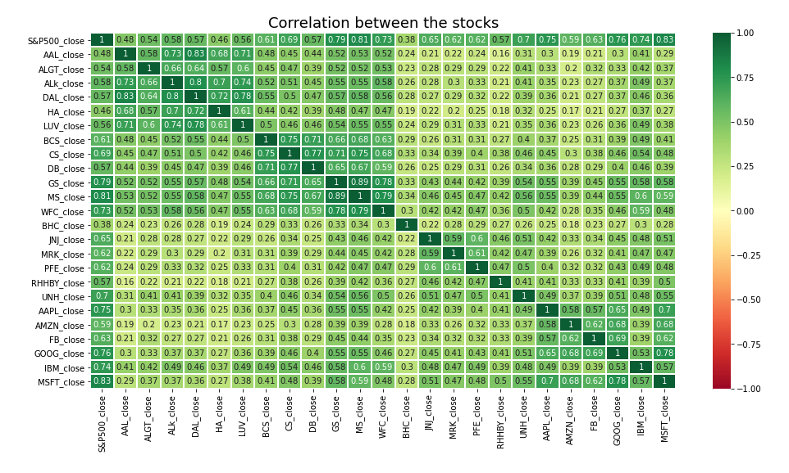
Correlation among the stocks
American Airlines(AAL) & Delta Airlines(DAL) are more correlated than Alaska Airlines(ALk) in the Aviation stocks
Goldman Sachs(GS), Morgan Stanley(MS) & Wells Fargo(WFC) stocks are correlated in the Finance Stocks
Pharma stocks are less correlated when compared to any other sector stocks
Technology Microsoft(MFST) and Google(GOOG) and AMZN(Amazon) are more correlated compared to other stocks.

Slide 12
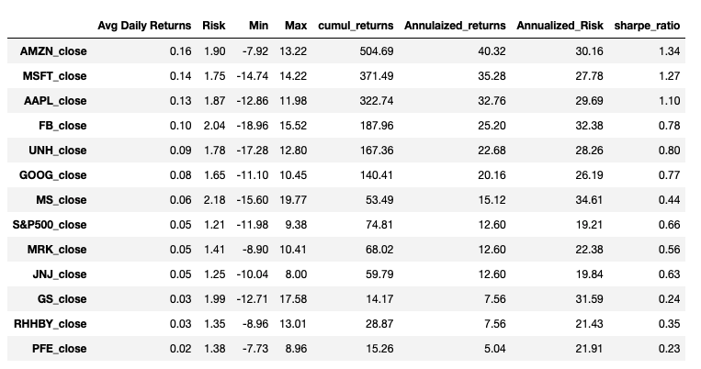
Final Stock Metrics.
By using these Metrics, we will find Portfolio performance.
AMZN,MSFT,AAPL are high return stocks with high Sharpe ratio.
MRK,JNJ,RHHBY,GS,PFE are low risk stocks

Slide 13
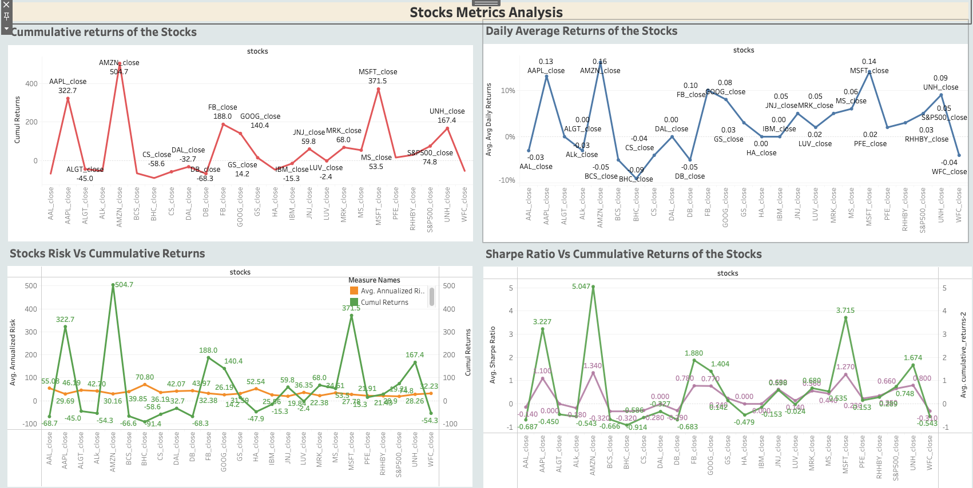
Visualisation of the Stock Metrics.
Key Findings
AMZN has High cumulative returns 504.7 with 30.16 Annual risk.
MSFT has High cumulative returns 371.5 with 27.78 Annual risk.
AMZN, MSFT , AAPL stocks are showing very high daily returns.
BCS,BHC,DB,ALK,AAL,CS,WFC are showing very low daily returns
BHC has very low Cumulative returns -91.4 with High risk 70.80.
AMZN has High cumulative returns 504.7 with 1.34 Sharpe ratio.
MSFT has High cumulative returns 371.5 with 1.27 Sharpe ratio.
APPL has high Cumulative returns 322.7 with 1.1 Sharpe ratio.

Slide 14
Portfolio Analysis
A mix of assets is what we call a Portfolio.
There are 2 Main critical factors in determining the security to include in the portfolio: the Return and Risk. However, there are other important factors as well which influence this decision.
Time plays an important role when selecting the securities for investment; we can also call it Investment TimeSpan.
It is also important to understand the investor and their underlying goals. Therefore, we utilize the following elements to suggest the appropriate portfolio to the investor.
Source of wealth
Measure of wealth
Stage of life

Slide 15
Investment Strategy:
Mr. Patrick
Mr. Peter
As per his profile Low risk stocks like JNJ, RHHBY, MRK, and high cumulative return stocks like AMZN, GOOG and MSFT is suitable to invest on to reach Mr. Patrick expected returns.
PFE has low cumulative returns though its risk is low.
As per his profile High risk/High Returns stocks like AMZN and MSFT is suitable to invest on. he will get maximum overall returns with high risk.

Slide 16
Portfolio Performance.
We should be considered some important parameters while building a portfolio.
Total Portfolio Risk : Standard Deviation metric provides the measure of risk in the portfolio. If the value is high, the underlying security is very volatile and has more exposure towards risk.
Total Cumulative returns : The cumulative return provides information on the aggregate gains earned by the investor over a period of time.
Sharpe ratio: Sharpe ratio helps the investor to realize the excess returns earned to endure the extra volatility of a riskier asset. it is expected that a good portfolio will have a high Sharpe ratio after diversification.

Slide 17
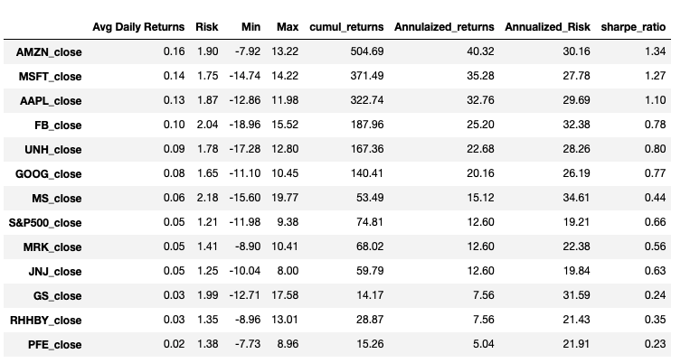
Mr.Patrics Portfolio Performance.
As per Mr.Ptaricks profile Low risk stocks like JNJ,RHHBY, MRK, and high cumulative return like GOOG and MSFT , AMZN is suitable to invest on to reach Mr.Patrics expected returns. same way PFE has low cumulative returns though its risk is low.
We tried couple of combination . In those which combination of stocks meet Mr. Patricks expected returns we will show here.
Portfolio 1:
'AMZN', 'JNJ', 'RHHBY' ,'MRK’
AMZN has high returns and other 3 stocks has low risk. For this portfolio, the metrics are:
Risk: 17.18%
Sharpe Ratio: 1.050%
Total Returns: 1143367.81
Portfolio 2:
‘MSFT', 'JNJ', 'RHHBY' ,'MRK’
MSFT has high returns and other 3 stocks has low risk. For this portfolio, the metrics are:
Risk: 18.00%
Sharpe Ratio: 0.924%
Total Returns: 1058232.52
Portfolio 3 :
‘AAPL', 'JNJ', 'RHHBY' ,'MRK’
APPL has high returns and other 3 stocks has low risk. For this portfolio, the metrics are:
Risk: 17.85%
Sharpe Ratio: 0.909%
Total Returns: 1038224.817
We recommend Portfolio 1 (AMZN,JNJ,RHHBY,MRK) for Mr. Patrick as you can see it has Total returns of 1143367.8 and with high Sharpe ratio 1.05% with low Risk 17.18%.

Slide 18
Mr. Peter Portfolio Performance.
As per Mr. Peter profile High risk/High Returns stocks like AMZN and MSFT is suitable to invest on. he will get maximum overall returns with high risk.
We tried couple of stock combinations. In those which combination of stocks meet Mr. Peters expectations we will show here.
Portfolio 1:
'AMZN
AMZN has high returns with high risk For this portfolio, the metrics are:
Risk: 30.11%
Sharpe Ratio: 1.34%
Total Returns: 6046877.6
Portfolio 2:
‘MSFT’, ‘AMZN’
MSFT and AMZN has high returns with high risk. For this portfolio, the metrics are:
Risk: 26.52%
Sharpe Ratio: 1.42%
Total Returns: 5523991.5
We recommend Portfolio 1 (AMZN) for Mr. Peter as you can see it has Total returns of 6046877.6 and with high Sharpe ratio 1.34% with high Risk 30.11%.
Notes:
.

Slide 19
Summary
Based on evaluation of the stock analysis and portfolio metrics.
For Mr. Peter, I recommend Portfolio with AMZN, which has Total returns of 6 million dollars with high Risk of 30.11%.
For Mr. Patrick, I recommend Portfolio with (AMZN,JNJ,RHHBY,MRK),which has Total returns of 1 million 143k with low Risk of 17.18% .

